Slide 1

PALMICO
REPORT
OWUSU COSBY ASARE

Slide 2


PALMICO
Palmico is a company producing biscuits.
In the production of their biscuits, they use Palm Oil.
Palmico is buying Palm oil from 15 direct suppliers.
These Suppliers also buy the Palm oil from different Mills

Slide 3
Suppliers Contribution to Green Score
NB:
Since Palmico’s Executive have decided to take action to increase Palmico’s deforestation free (green) score, its best to work with Supplier G because From the chart, Supplier G contribute the most to deforestation free (green) score. Supplier G contribute 12,284.56 (MT) volume to green score which is twice more than any other Palmico Supplier.

Slide 4
DATA FACTS
From the Dashboard on the next slide, its Show Malaysia is the Country that produce the most volume of Palm Oil and contribute the most volume to deforestation free (green) score to Palmico. Next to Malaysia is Indonesia.
It also displays the total amount/ Volume of Palm oil contributed to Green Score, Red Score and Yellow Score deforestation.
The dashboard also show the discrepancies in the data with was as a results of red, green and yellow score which didn’t add up to 100%
Deep analysis of Suppliers contribution to green score reveals that, Every Volume of Palm oil (100%) from Direct Supplier C contributes to the deforestation free (green) score of Palmico Company. Also Direct Supplier D and Direct Supplier M also has most of its volume of Palm oil (68.36% and 49.95% respectively) contribute to Green Score.
Supplier E produce the most volume of Palm Oil to Palmico with 39,905.27 (MT), followed by Supplier A and Supplier G with 14,768.83 (MT) and 13538.46 (MT) respectively.

Slide 5
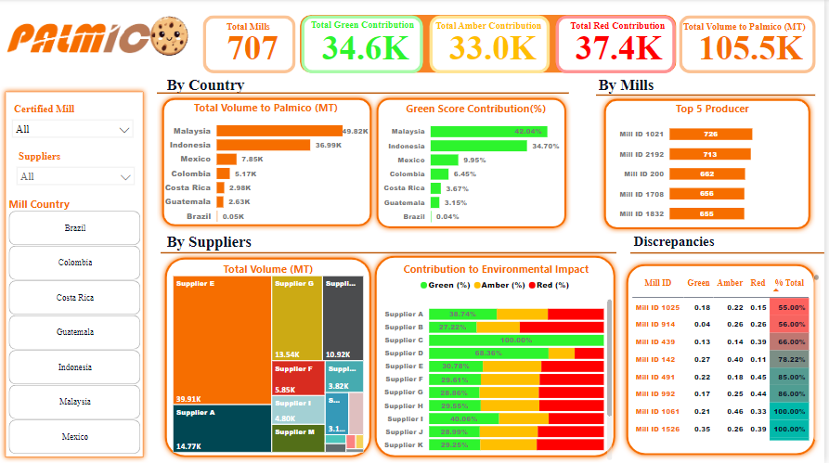
DASHBOARD PREVIEW

Slide 6
THANK YOU
OWUSU COSBY ASARE

